Slide 1
CLASSIFICATION WITH BIG DATA
EAS 508

Slide 2
PRESENTED BY:
BHARADWAJ DONTHULA
JASON CABALLES
VINAYA SANTHOSH KUMAR
KARTHIK SRI SAKTHI DEGALA

Slide 3
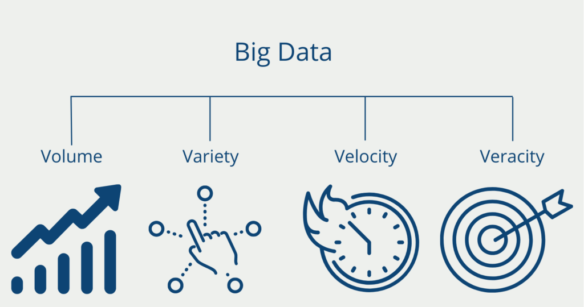
Introduction to Big Data
Big data encapsulates the vast and diverse collection of information characterized by its unprecedented volume, encompassing structured, unstructured, and semi-structured data.
Big data represents the monumental volume, variety, velocity, veracity,
Volume: Massive amounts of data generated continuously.
Variety: Diverse data types
Velocity: High-speed generation and processing of data.
Veracity: Uncertainty and reliability of data.

Slide 4
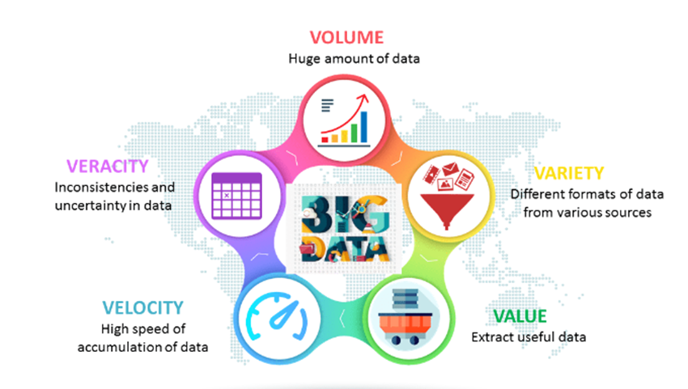
Big Data
Big Data concern large-volume, growing data sets that are complex and have multiple autonomous sources.
• 5 Vs of Big Data:
Volume
Velocity
Variety
Veracity
Value

Slide 5



Big Data Frameworks
Hadoop
Apache Spark
Cassandra

Slide 6
Big data issues when applying classification algorithms
Data Volume and Scalability:
Big data is characterized by its massive volume, which can be challenging for traditional classification algorithms.
Processing and analyzing large datasets may require extensive computational resources and may lead to longer processing times.
Solution : Distributed Computing:
1.Big data frameworks like Hadoop and Apache Spark can distribute data and computation across multiple nodes, enabling the parallel processing of large datasets.
2.This helps address the scalability issue and allows classification algorithms to work efficiently. Hadoop uses HDFS

Slide 7
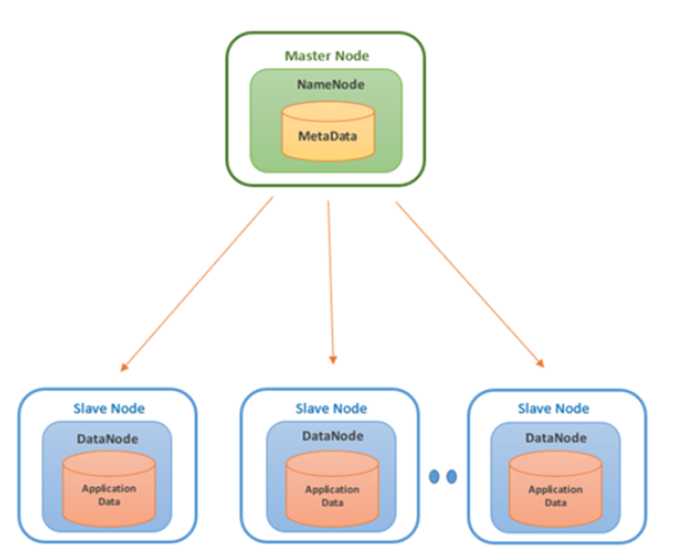
HDFS
Primary storage system used by Hadoop applications.
•Nodes: Master-slave nodes typically forms
the HDFS cluster.
1.NameNode(MasterNode)
2.DataNode(SlaveNode)

Slide 8
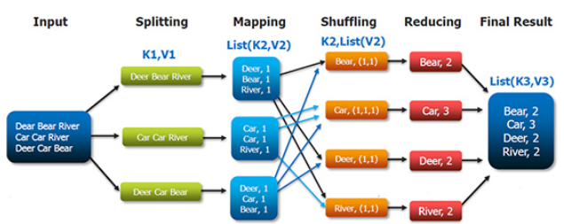
MapReduce
Performs processing of large data
sets in distributed and parallel
manner.
Consists of two tasks:
Map
Reduce
Essential daemons of MapReduce:
Job Tracker
Task Tracker

Slide 9
Big data issues when applying classification algorithms
Feature Engineering and Dimensionality:
High-dimensional feature spaces are a common component of big data apps.The drawbacks of dimensionality include overfitting, higher processing costs, and challenges in identifying pertinent features.
Techniques for dimensionality reduction and feature selection aid in enhancing the efficacy and efficiency of classification systems.
Imbalanced Data:
Data may be unbalanced in many real-world situations, with one class substantially outnumbering others.
In order to prevent biased models and guarantee equitable representation of minority classes, classification algorithms might need to be handled with extra care.
Model Selection and Interpretability:
It can be difficult to select the best classification algorithm for a given situation.
Deep learning and other more complex models may achieve high accuracy but lack interpretability, which is important in some applications.
Privacy and Security:
Strong privacy and security measures are necessary when handling sensitive data in big data classification.

Slide 10
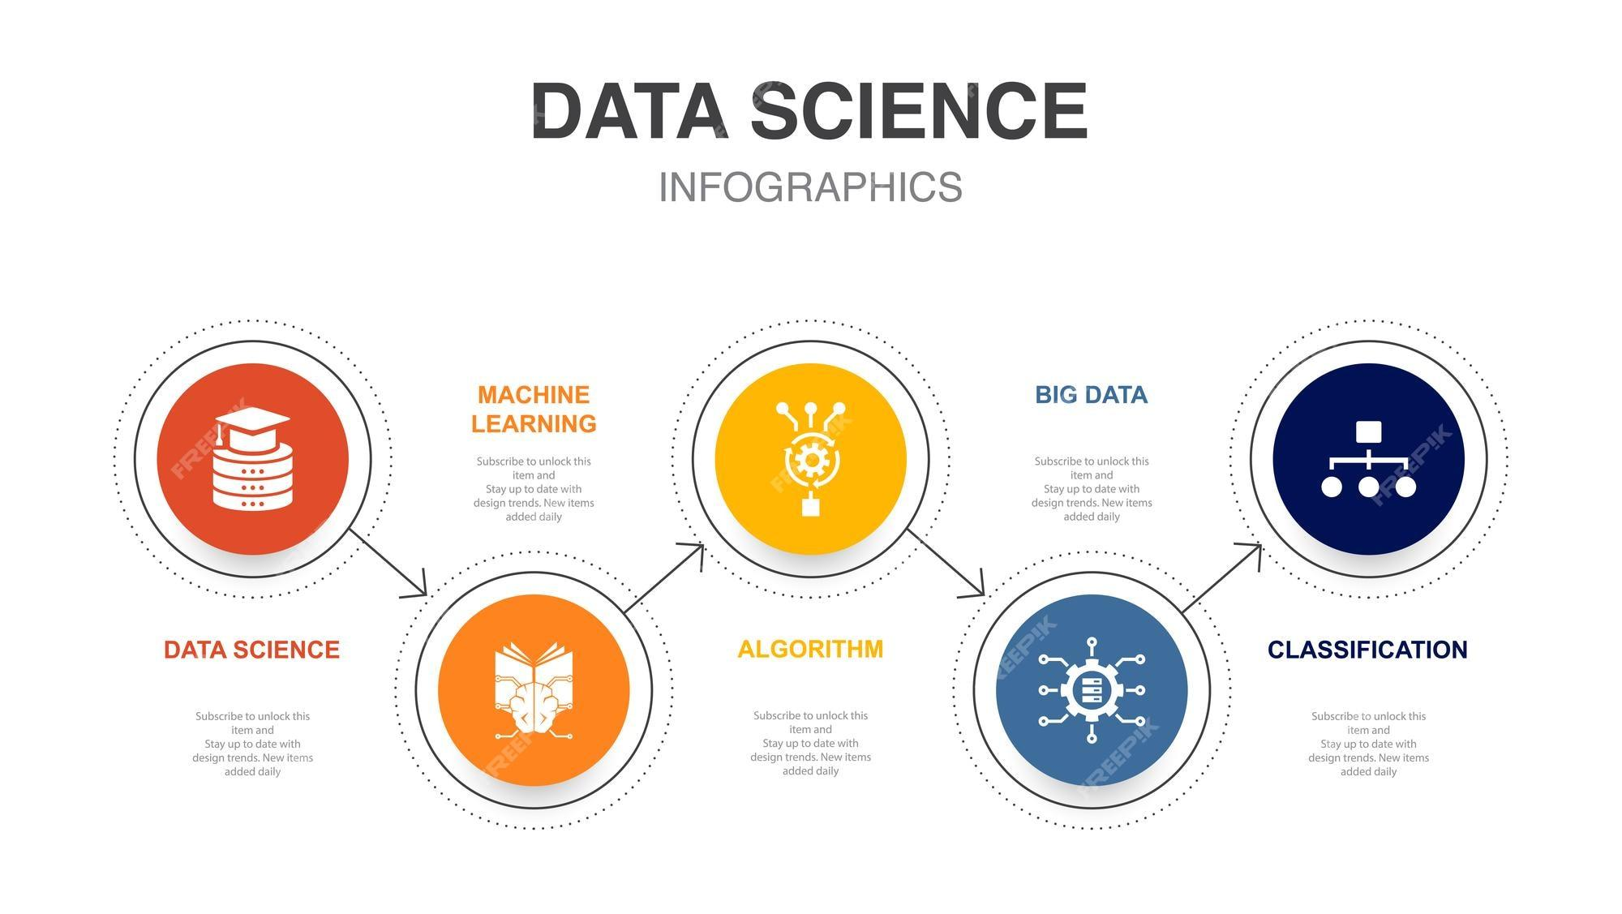
Significance of Bigdata Classification:
Big data classification integrates advanced algorithms and technologies to discern patterns, make predictions, and facilitate decision-making on an extensive scale.
Pattern Recognition: Uncovering hidden patterns within massive datasets.
Prediction: Forecasting future trends and outcomes based on historical data.
Decision-making: Empowering informed decisions across various domains using data-driven insights.

Slide 11
What is data classification?
Data classification is the process of organizing data into predefined categories. This process involves identifying and analyzing the characteristics of data and assigning it to appropriate categories based on those characteristics. Data classification is used in a wide variety of applications, including:
Risk management: Classifying data based on its sensitivity level helps organizations prioritize their security efforts and protect their most valuable assets.
Compliance: Classifying data according to regulatory requirements ensures that organizations adhere to data privacy laws and avoid legal penalties.
Data discovery: Classifying data makes it easier to find and retrieve relevant information, improving decision-making processes and operational efficiency.

Slide 12
Types of Data Classification
There are three main types of data classification:
Supervised learning: In supervised learning, data is labeled with its correct category before it is used to train a classification model. The model learns from the labeled data and can then be used to classify new, unlabeled data.
Unsupervised learning: In unsupervised learning, data is unlabeled, and the model is tasked with identifying patterns and groupings within the data. This type of learning is useful for tasks such as customer segmentation and anomaly detection.
Semi-supervised learning: Semi-supervised learning combines supervised and unsupervised learning. A small amount of labeled data is used to train the model, and the model is then used to label a larger amount of unlabeled data. This approach can be useful when there is limited labeled data available.

Slide 13
Supervised Learning
Supervised learning is a machine learning technique that uses labeled data to train a model that can then be used to classify new, unlabeled data.
K-nearest neighbors: This algorithm classifies new data points based on the majority class of their nearest neighbors in the training data.
Support vector machines: This algorithm finds a hyperplane that separates the data points into two classes.
Decision trees: This algorithm builds a tree-like structure that represents the decision-making process for classifying data points.
Random forests: This algorithm combines multiple decision trees to improve classification accuracy.
Naive Bayes classifiers: This algorithm assumes that features are independent of each other and uses Bayes' theorem to classify data points.

Slide 14
Unsupervised Learning
Unsupervised learning is a machine learning technique that uses unlabeled data to identify patterns and groupings within the data.
Common unsupervised learning algorithms
K-means clustering: This algorithm groups data points into a predefined number of clusters based on their similarity.
Hierarchical clustering: This algorithm builds a hierarchy of clusters by repeatedly merging or splitting clusters.
Principal component analysis (PCA): This algorithm reduces the dimensionality of data by identifying the most important features.

Slide 15
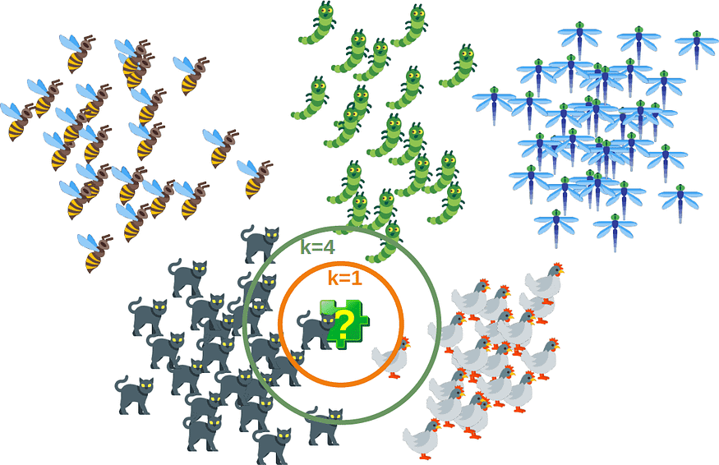
K-Nearest Neighbors (KNN)
What is the K-Nearest Neighbors (KNN) algorithm?
The K-nearest neighbors (KNN) algorithm is a simple and effective machine learning algorithm. It is a non-parametric algorithm, which means that it does not make any assumptions about the underlying data distribution.
.
Notes:
What is the K-Nearest Neighbors (KNN) algorithm?
The K-nearest neighbors (KNN) algorithm is a simple and effective machine learning algorithm. It is a non-parametric algorithm, which means that it does not make any assumptions about the underlying data distribution.
How does the KNN algorithm work?
The KNN algorithm works by identifying the K nearest neighbors (data points) to a new data point. The majority class of these K nearest neighbors is then used to classify the new data point. The value of K is a hyperparameter that can be tuned to improve the performance of the algorithm.

Slide 16
HOW DOES K-Nearest Neighbors (KNN) WORK?
Training Phase: The algorithm is trained on a set of labeled data points. Each data point consists of a vector of features and a corresponding class label.
Distance Calculation: When a new data point is presented for classification, the algorithm calculates the distance between it and all the training data points. The distance metric used depends on the nature of the data, with Euclidean distance being the most common choice.
Identifying Nearest Neighbors: The k nearest neighbors (kNN) are selected, where 'k' is a hyperparameter that determines the number of neighbors to consider. The choice of k significantly affects the classification performance.
Class Label Determination: The class label of the new data point is determined based on the class distribution of its k nearest neighbors. The most common approach is majority voting, where the class with the most occurrences among the nearest neighbors is assigned to the new data point.
Voting Tie-Break: If the class distribution is evenly divided among the nearest neighbors, a tie-breaking mechanism may be employed. This could involve assigning the new data point to the class with the highest overall frequency in the training data or using more sophisticated methods like weighted voting.
Notes:
Strengths:
Easy to understand and implement
No need to train a model upfront
Effective for data with high dimensionality
Can handle non-linear relationships between features
Weaknesses:
Sensitive to outliers
Can be computationally expensive for large datasets
Low performance for high-density data
Requires careful selection of the K hyperparameter

Slide 17
K-Nearest Neighbors (KNN)
KNN in Action
Consider a scenario where you have a dataset of images of different animals, such as dogs, cats, and horses. You want to use machine learning to classify new images into these three categories. You can use the KNN algorithm for this task.
First, you would need to train the KNN algorithm on the labeled dataset of images. This would involve identifying the K nearest neighbors for each image in the training set and assigning the class label of the majority class of those neighbors to that image.
Next, you would use the trained KNN algorithm to classify new images. For each new image, you would identify the K nearest neighbors in the training set and assign the class label of the majority class of those neighbors to the new image.

Slide 18
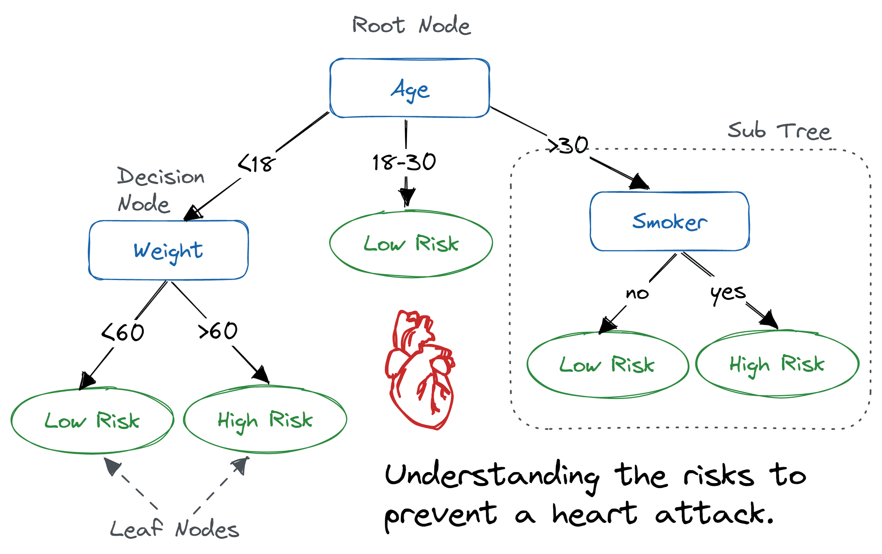
Decision Trees
What are decision trees?
Decision trees are tree-like structures that represent the decision-making process for classifying data points. The tree starts with a root node and then splits into multiple branches based on the values of the features.
Notes:
Each branch leads to a leaf node, which represents the class of the data point.
Entropy is a measure of the uncertainty or randomness in a set of data.

Slide 19
How do Decision Trees work?
Selecting the Best Attribute: Algorithm picks the most informative attribute using metrics like Gini impurity or entropy to distinguish classes within the dataset effectively.
Splitting the Dataset: Chosen attribute partitions data into subsets, each holding instances associated with distinct values of that attribute, aiding in refining classification.
Recursive Partitioning: Iterative process divides subsets further, forming a tree structure until meeting defined stopping conditions, like tree depth or sample count.
Creating Leaf Nodes: Subsets continue dividing until reaching a point where no further splits occur, forming leaf nodes that assign predicted classes.
Prediction: Traversing from root to leaf nodes based on data features, the tree determines the predicted class label for a new data point.
Notes:
Decision Tree Construction:
The decision tree is constructed by recursively partitioning the data into smaller subsets based on certain criteria. The splitting criteria are chosen to maximize the information gain, which represents the reduction in uncertainty after splitting the data.
Splitting Criteria:
Common splitting criteria include:
Gini Impurity: Measures the probability of misclassifying a randomly chosen data point.
Entropy: Measures the uncertainty or randomness in the data.
Cross-Entropy: A generalization of entropy that handles continuous features.
Pruning:
After the tree is constructed, it may be pruned to reduce overfitting. Overfitting occurs when the tree becomes too complex and memorizes the training data, leading to poor performance on unseen data. Pruning involves removing unnecessary branches to simplify the tree and improve its generalization ability.
Decision Tree Classification:
To classify a new data point, the algorithm traverses the decision tree from the root node to a leaf node based on the values of the data point's features. The class label assigned to the new data point is the one associated with the leaf node.

Slide 20
Decision Trees
Decision Trees in Action
Consider a scenario where you have a dataset of patients and you want to use machine learning to predict whether they have a particular disease. You can use a decision tree to make these predictions.
First, you would need to train the decision tree on a labeled dataset of patients. This would involve recursively splitting the data into smaller subsets based on the values of the features, such as age, gender, and medical history. The splits would be chosen to maximize the information gain.
Next, you would use the trained decision tree to make predictions for new patients. For each new patient, you would determine their position in the tree and classify them accordingly.

Slide 21
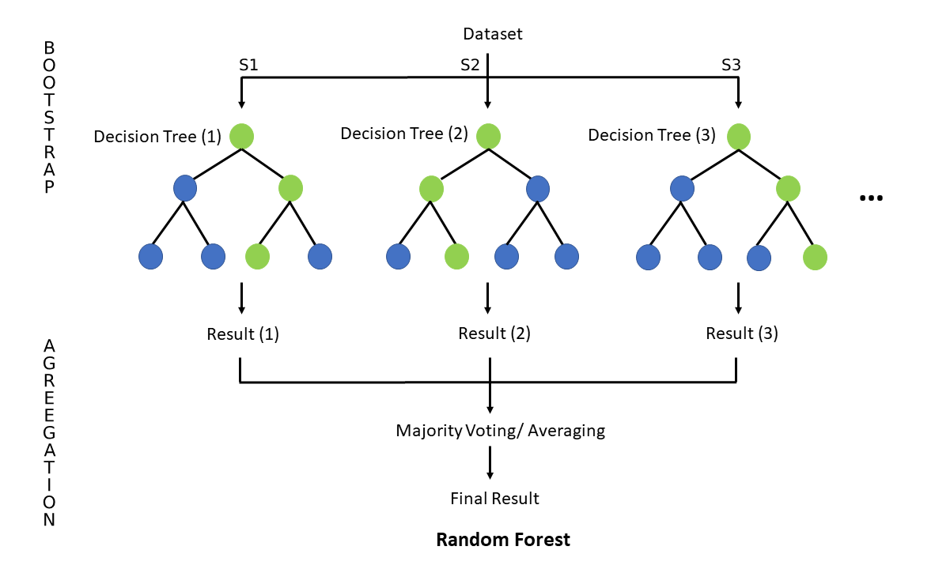
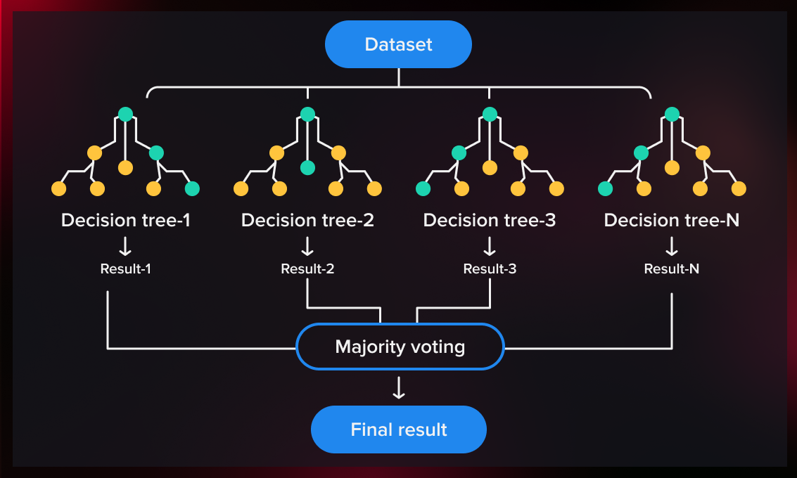
Random Forests
What are random forests?
Decision trees that are grown very deep tend to learn highly irregular patterns and overfit their training sets, i.e. have low bias, but very high variance. Random forests are a way of averaging multiple deep decision trees, trained on different subsets of the training data with the goal of reducing the variance and improve classification accuracy. This comes at the expense of a small increase in the bias and some loss of interpretability, but generally greatly boosts the performance in the final model. For classification tasks, the output of the random forest is the class selected by most trees.

Slide 22
How does Random Forest work?
Random Sampling of Observations: For each tree in the forest, a random sample of the data is chosen (with replacement) from the original dataset. This process is called bootstrapping. This sampling ensures that each tree is trained on slightly different data, introducing diversity among the trees.
Random Feature Selection:
For each tree in the Random Forest, a random subset of features is selected from the available features (Feature Bagging). This randomness helps to reduce the correlation between the trees and improve the overall accuracy.
Decision Tree Construction:
Using the bootstrapped subsets of data and the selected subset of features, individual decision trees are constructed. Each tree is built by recursively splitting the data based on the selected features until certain stopping criteria are met (e.g., maximum depth, minimum samples per leaf, etc.).
Notes:
For high-dimensional data using Enriched Random Forest (ERF) where Use weighted random sampling instead of simple random sampling at each node of each tree, giving greater weight to features that appear to be more informative

Slide 23
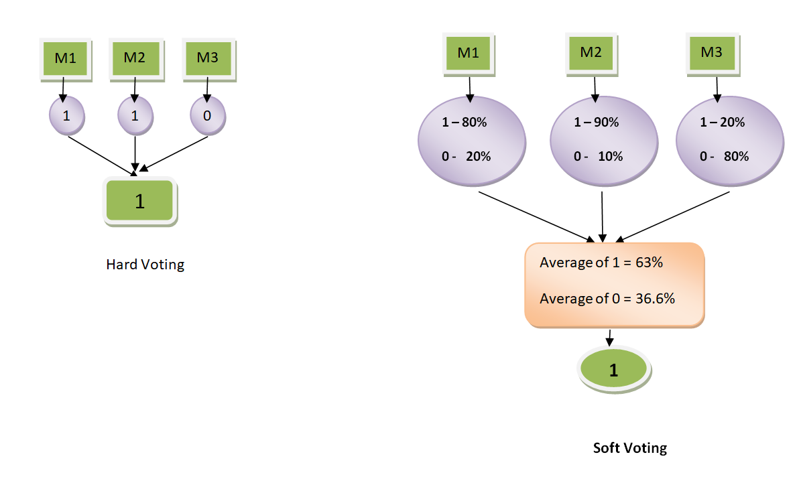
Random Forests
Voting for Predictions / Aggregation:
Hard Voting: In hard voting, each tree gives a single vote for a class, and the most frequent class prediction among all trees is chosen as the final prediction.
Soft Voting: In soft voting, each tree provides a probability distribution for each class. The final prediction is determined by averaging these probabilities across all trees and selecting the class with the highest average probability.
Parameter Tuning: Tuning hyperparameters like number of trees in the forest, the depth of each tree, and the number of features considered at each split optimizes the Random Forest model for better performance.

Slide 24
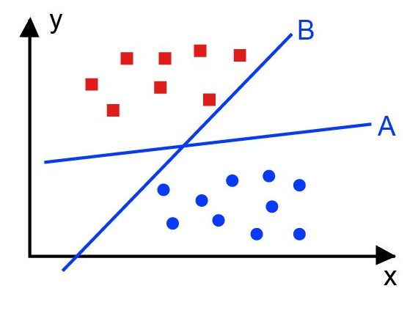
Support Vector Machines (SVMs)
What are support vector machines (SVMs)?
SVMs are commonly used for classification tasks, aiming to categorize data points into different classes.
In binary classification, SVMs aim to find the optimal hyperplane that separates the classes with maximum margin. Margin is the distance between the hyperplane and the nearest data points of each class.
The position of the hyperplane in the feature space is determined by support vectors - the data points closest to the hyperplane.
Notes:
By selecting the tuning parameter we can control the fit on the training data
alpha- weights, lambda-tuning parameter

Slide 25
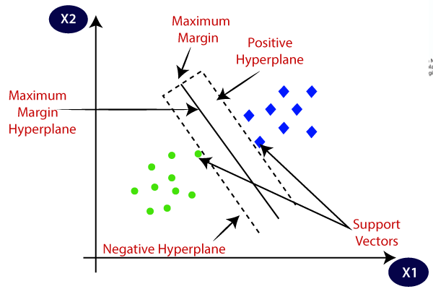

How does Support Vector Machine work?
Soft Margin and Regularization (C parameter):
In situations where the data is not perfectly separable, SVM can allow some misclassifications by using a soft margin. By introducing a penalty term (C) we can balance the trade-off between maximizing the margin and minimizing the classification error. A smaller 'C' allows for a wider margin but may tolerate more misclassifications, while a larger 'C' penalizes misclassifications more and aims for a smaller margin.
Notes:
The soft margin in Support Vector Machine (SVM) classification is an approach that permits a degree of misclassification in the training data to find a hyperplane that better handles non-linearly separable or noisy datasets by introducing a penalty term (C) that balances margin size and misclassification tolerance.

Slide 26
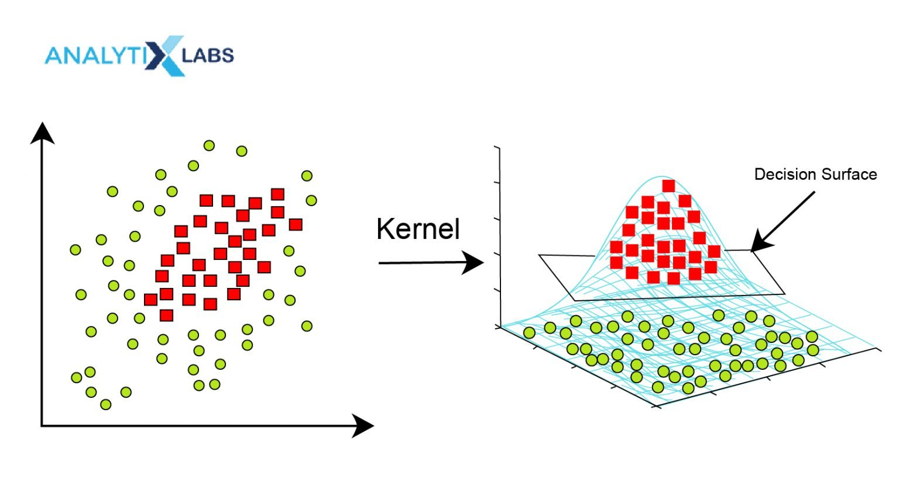
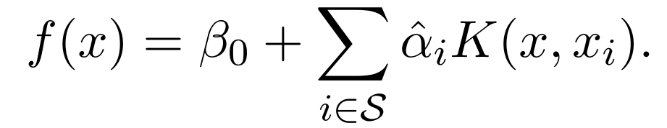
Kernel Method:
In cases where the data is not linearly separable in its original feature space, we use kernels to map the data into a higher-dimensional space where it can become linearly separable. Popular kernels include linear, polynomial, radial basis function (RBF), and sigmoid kernels.
Multi-Class Classification:
For multi-class classification tasks, we xtend binary classification by using strategies like one-vs-rest (OvR) or one-vs-one (OvO)..

Slide 27
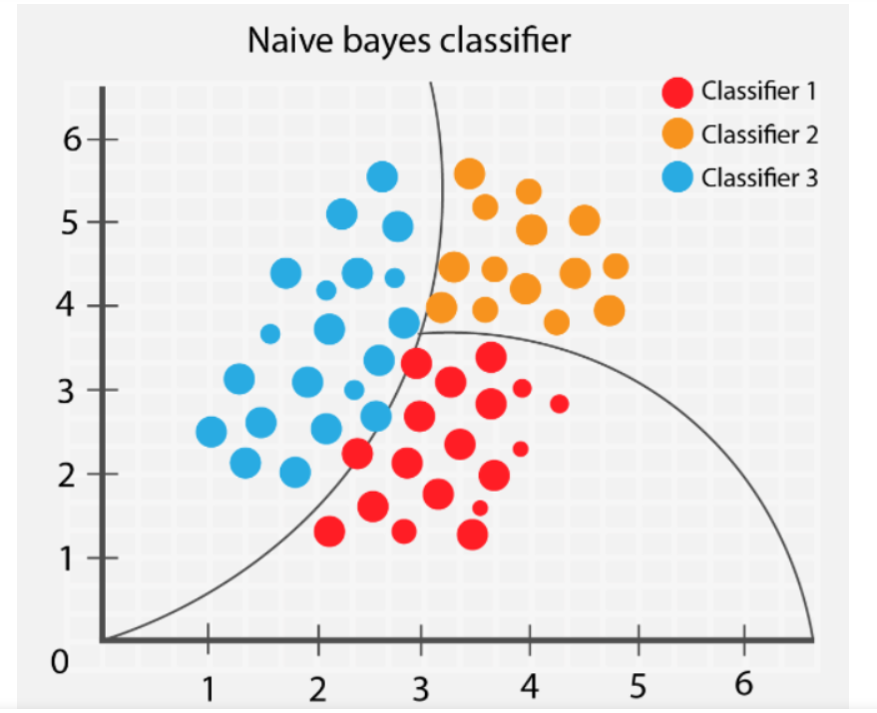
Naive Bayes Classifiers
What are naive Bayes classifiers?
Naive Bayes classifiers are a family of machine learning algorithms that use Bayes' theorem to classify data points. Bayes' theorem is a probability formula that can be used to calculate the probability of an event occurring given some evidence.
How do naive Bayes classifiers work?
Naive Bayes classifiers work by calculating the posterior probability of each class for a given data point. The class with the highest posterior probability is assigned to the data point.
Notes:
what are naive bayes Naive Bayes classifiers assume that features are independent of each other, which is often not the case in reality.
how does it work
The posterior probability is the probability that a data point belongs to a particular class given the values of its features.

Slide 28
Naive Bayes Classifiers
The Naive Bayes algorithm makes the following assumptions:
The features of a data point are independent of each other.
The features are distributed according to a probability distribution.
To train a Naive Bayes classifier, we need to provide the algorithm with a training dataset that contains labeled data points. The labels indicate which class each data point belongs to.
The Naive Bayes algorithm works by first calculating the probability of each feature occurring for each class.
This is done by counting the number of times each feature occurs in each class and dividing by the total number of data points in the training dataset.
Once the probability of each feature occurring for each class has been calculated, the Naive Bayes algorithm can then classify a new data point by calculating the probability of the data point belonging to each class and then choosing the class with the highest probability.
Notes:
redundant - Jason

Slide 29
Naïve Bayes Classifier (NBC)
How can we improve it?
We will improve the NBC for discrete predictors

Slide 30
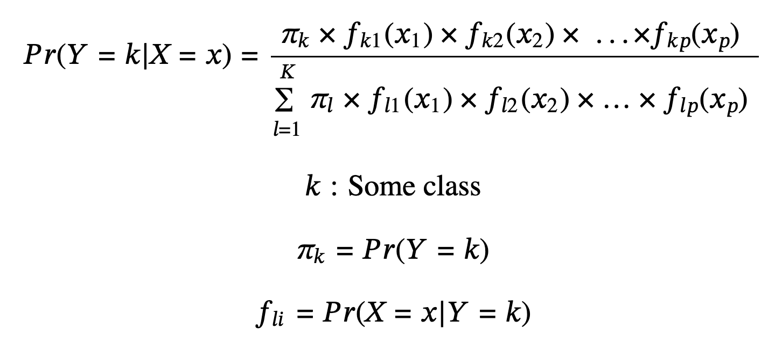
Recall the NBC formula

Slide 31
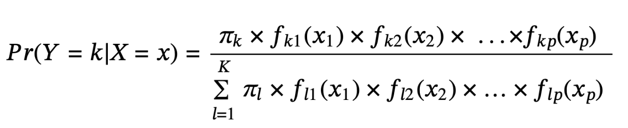
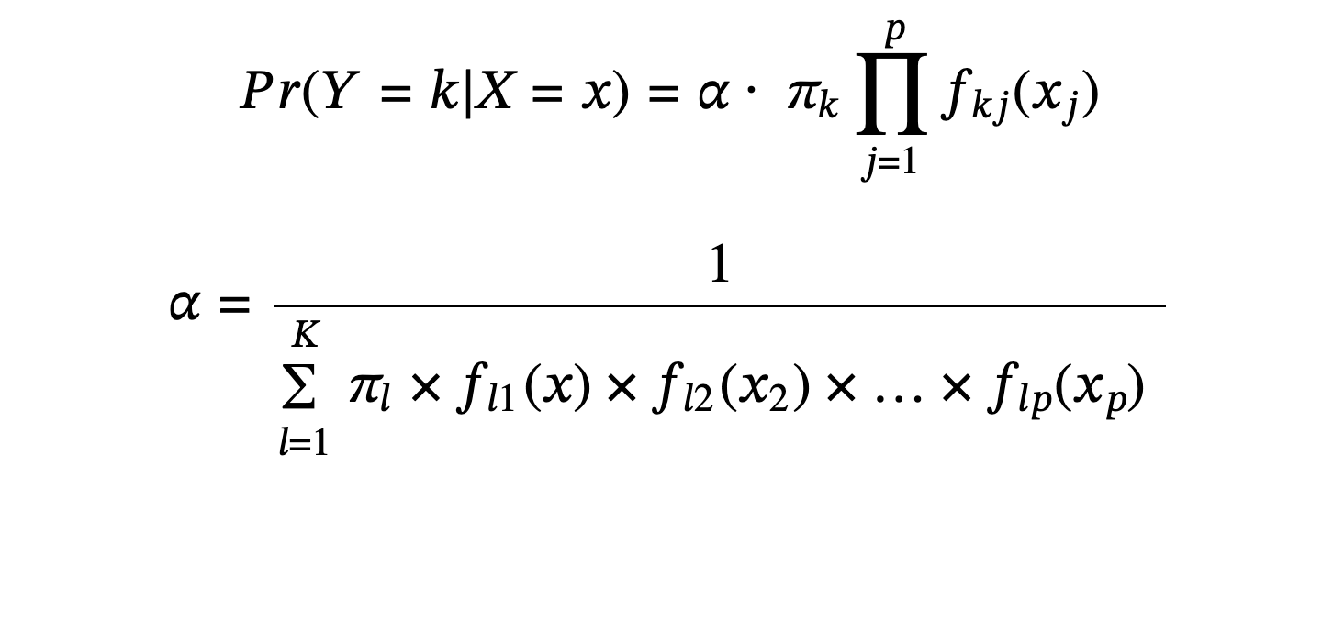
Collapsing the NBC we have

Slide 32
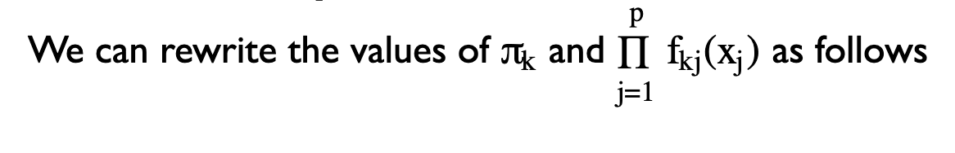
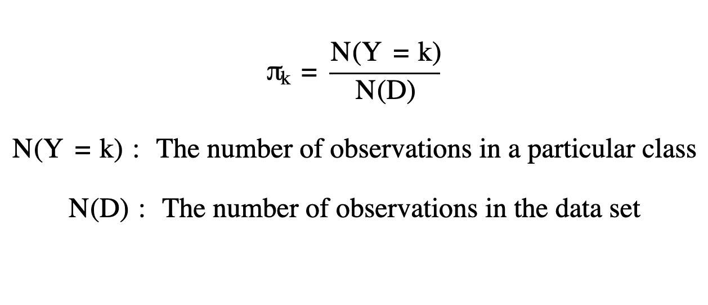
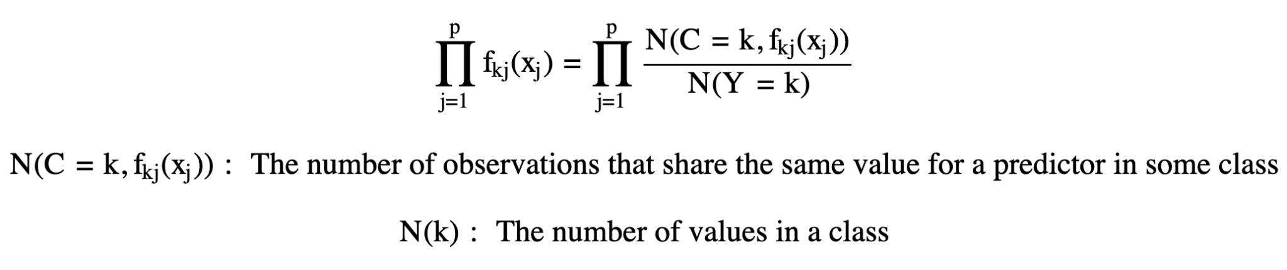

Slide 33
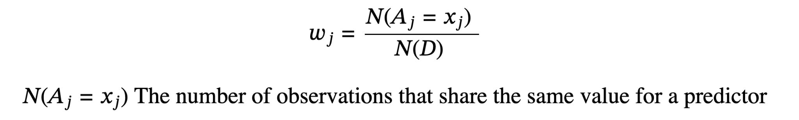
We can define weights for each predictor as follows

Slide 34
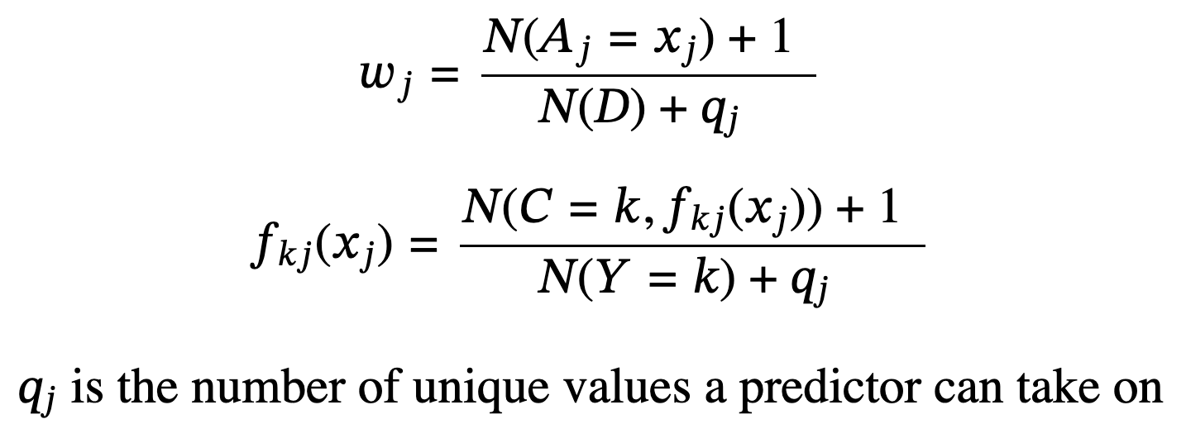
We will apply a Laplacian calibration to the weights and each predictor's probability

Slide 35
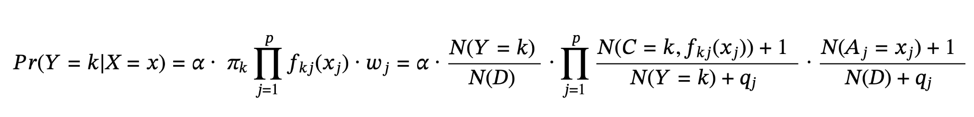
Now rewriting NBC with the weights and Laplacian calibration, we have

Slide 36
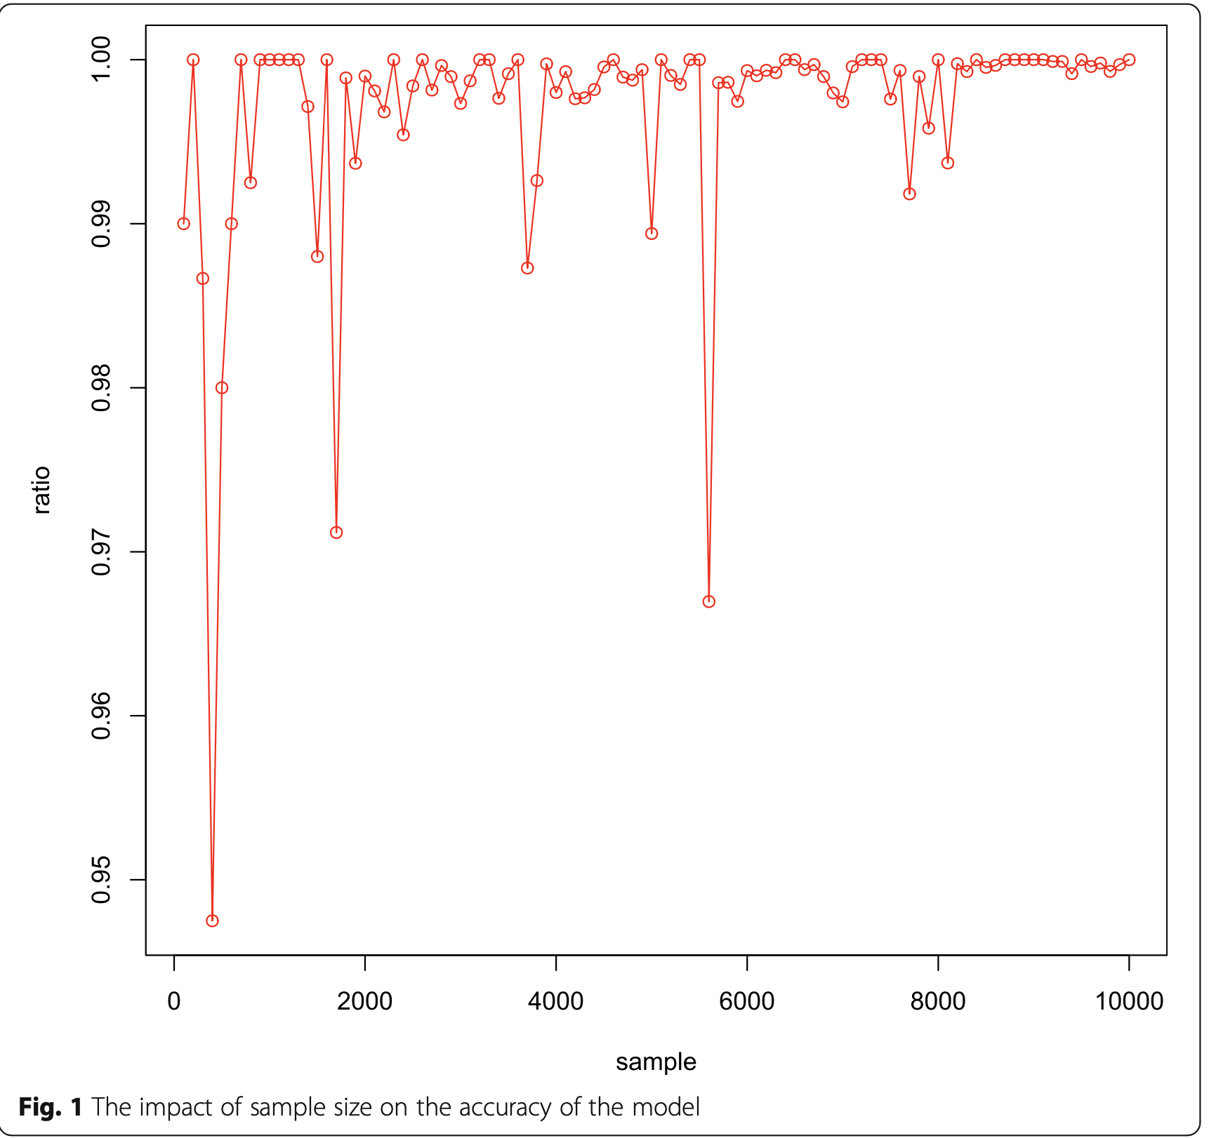
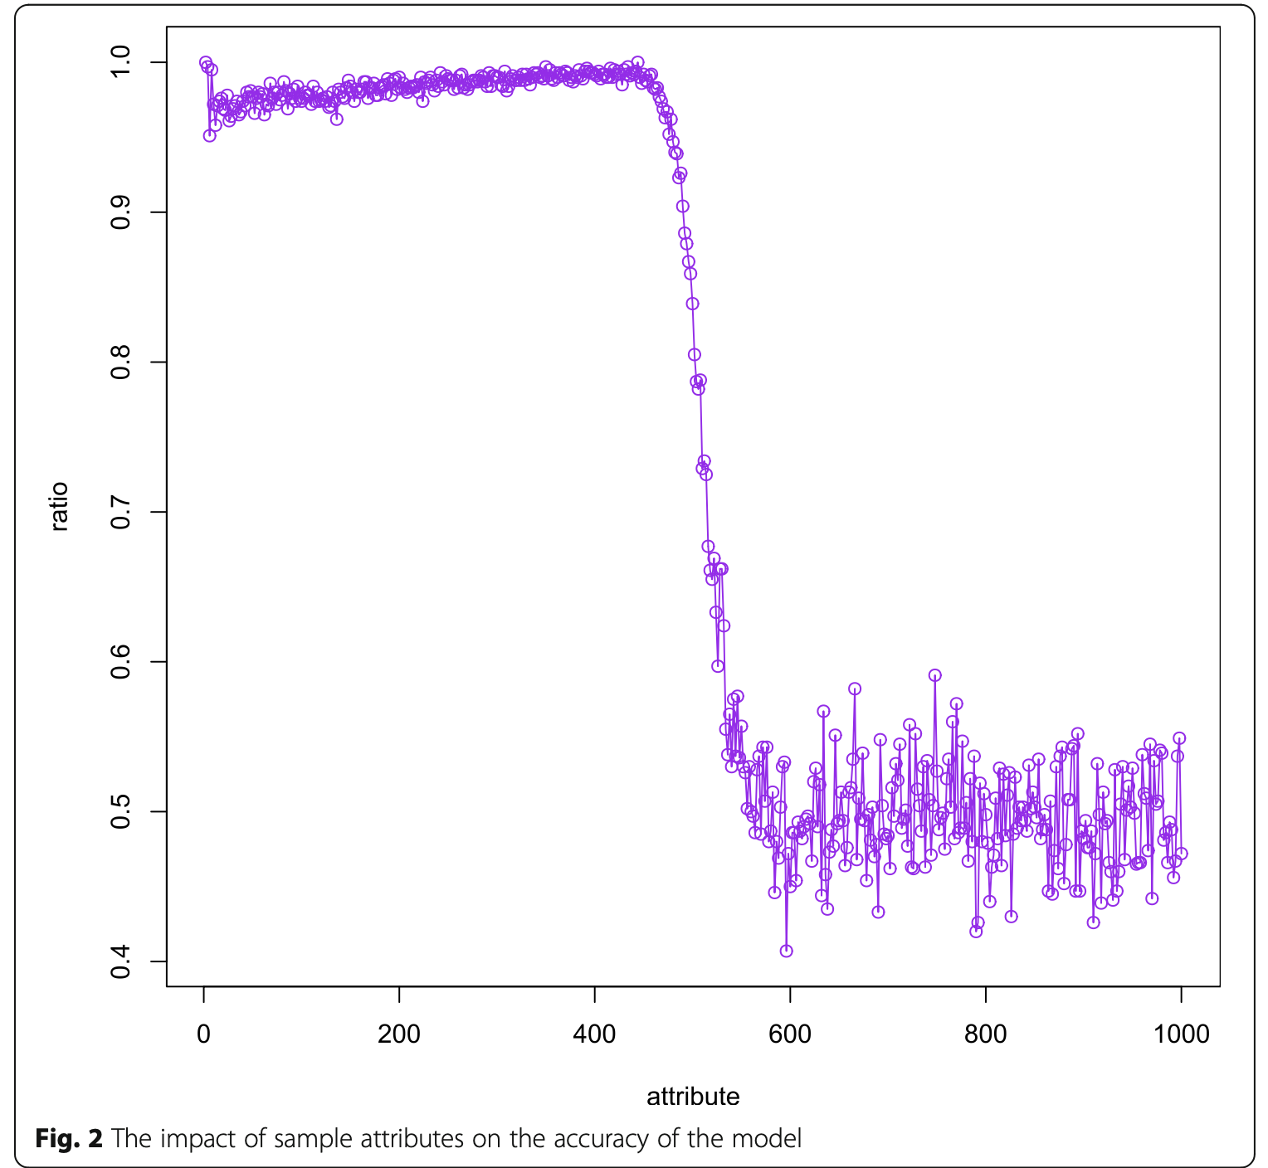
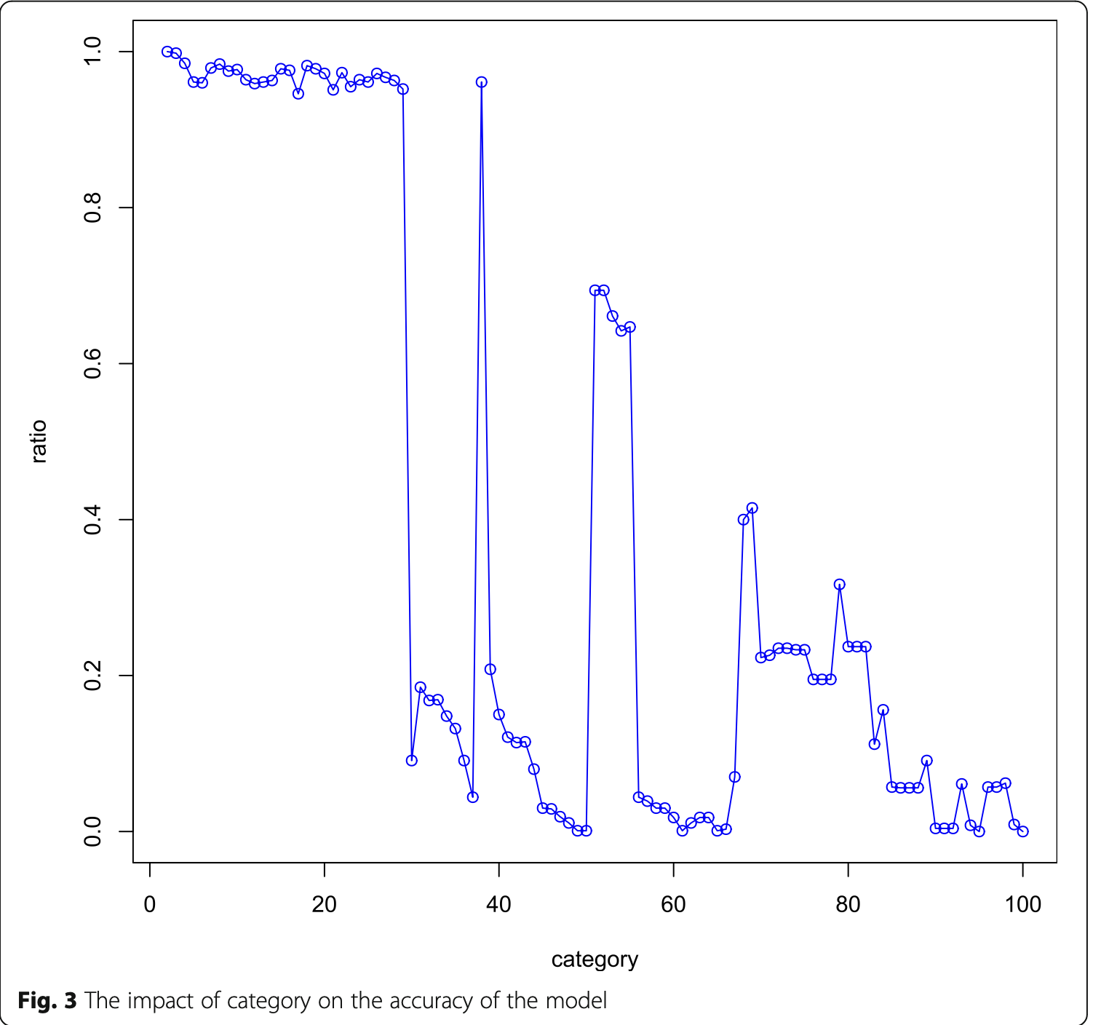
Testing The NBC in Simulated Data
Accuracy vs Sample Size
Accuracy vs Predictors
Accuracy vs Classes

Slide 37
Additional Applications and Future Directions
Risk Assessment: Classifying individuals or entities based on their risk profile, such as creditworthiness or insurance risk.
Anomaly Detection: Identifying unusual patterns or outliers in data that may indicate anomalies, fraud, or system failures.
Recommendation Systems: Recommending products, services, or content to users based on their past behavior, preferences, or similar user profiles.
Content Moderation: Automatically flagging and reviewing potentially harmful or inappropriate content on social media platforms or online communities.
Scientific Research: Classifying data from experiments, simulations, or observations to identify patterns, relationships, and potential hypotheses.
Notes:
Impact Classification with data has revolutionized various industries and continues to evolve at a rapid pace. As machine learning algorithms become more sophisticated and data availability increases, the applications of classification will expand further. We can expect to see even more innovative and impactful use cases in areas such as healthcare, finance, education, and environmental monitoring.

